Slide 1
Title of the paper
[Central Gothic Bold 44 pt]
CONCORDIA UNIVERSITY – LOYOLA CAMPUS
First Author, Second Author, Third Author
[Central Gothic Bold 24 pt]
First affiliation, Address, City, and Postcode, Country
Second affiliation, Address, City and Postcode, Country
[Central Gothic Regular 18 pt]
5th International Conference on Building Energy and Environment – Montreal, Canada
Institution
Logo

Slide 2
Headline [Century Gothic Bold 32 pt]
Palatino Linotype Regular 24 pt
For full papers, the oral presentation is maximum 12 minutes in length
For extended abstracts, the oral presentation is maximum 5 minutes in length
After the presentation, 3 minutes are reserved for questions
Consider approximately 1 minute per slide
The slides can be prepared as PowerPoint or PDF-presentations
We suggest the use of this document as a template if you use PowerPoint
You must pre-record your presentation if you’re attending the conference virtually.
5th International Conference on Building Energy and Environment – Montreal, Canada
[Title of the paper]
[Presenter’s name]

Slide 3
Headline [Century Gothic Bold 32 pt]
Palatino Linotype Regular 24 pt
Please write short sentences, and assist with illustrations
Avoid using more than 2-3 colors for text and illustrations
Avoid using only capital letters and underlining
Avoid extensive use of fading and other animations
5th International Conference on Building Energy and Environment – Montreal, Canada
[Title of the paper]
[Presenter’s name]

Slide 4
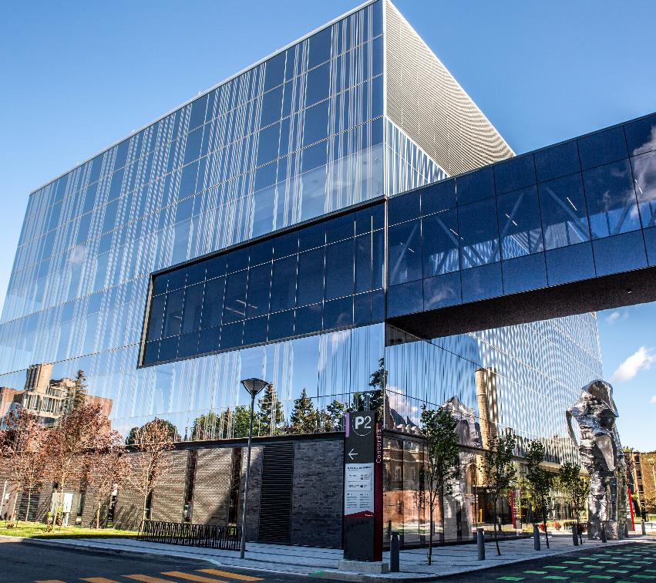
Headline [Century Gothic Bold 32 pt]
Palatino Linotype Regular 24 pt
Practice the presentation so you don’t exceed the timing
The information given in this template is suggested. Presenters are encouraged, but not required to conform to these suggestions
See you soon in Montreal!
5th International Conference on Building Energy and Environment – Montreal, Canada
[Title of the paper]
[Presenter’s name]

Slide 5
Thank you!
[Presenter’s name]
[Presenter’s email contact]
5th International Conference on Building Energy and Environment – Montreal, Canada

